Slide 1
Pneumonia detection using
CNN
Presented by,
M . MANIMATHAVAN
Reg.No. :912321104024
III-year , CSE
SACS MAVMM ENGINEERING COLLEGE

Slide 2
Project outline:
Problem statement
Proposed system/solution
System development approach
Algorithm and deployment
Result
conclution

Slide 3
Problem Statement:
Pneumonia is a life-threatening respiratory condition that requires early detection and intervention for effective treatment. Traditional methods of diagnosing pneumonia, such as chest X-rays and clinical assessments, can be time-consuming and prone to human error. Leveraging the power of Convolutional Neural Networks (CNNs), the goal of this project is to develop an automated pneumonia detection system that accurately identifies pneumonia patterns in chest X-ray images.

Slide 4
Proposed system/solution:
Data Collection and Preprocessing:Gather a diverse dataset of chest X-ray images labeled as either pneumonia-positive or pneumonia-negative
.Preprocess the images by resizing them to a standard size, normalizing pixel values, and augmenting the dataset to increase variability. Model Architecture Design:Design a CNN architecture suitable for pneumonia detection, typically involving convolutional layers for feature extraction followed by fully
Training:Split the dataset into training, validation, and test sets.Train the CNN model on the training data using techniques like mini-batch gradient descent and backpropagation.
Evaluation:Evaluate the trained model on the test set to assess its performance in pneumonia detection.

Slide 5
Proposed System/solution (cond...)
Deployment:Deploy the trained CNN model as a service or integrate it into a healthcare system for automated pneumonia detection.
Provide a user-friendly interface for uploading chest X-ray images and obtaining the model’s prediction of pneumonia presence.
Performance Monitoring and Maintenance:Continuously monitor the performance of the deployed system in real-world settings.
Integration with Clinical Workflow:Integrate the pneumonia detection system seamlessly into the clinical workflow of healthcare facilities.
Provide tools for radiologists and clinicians to review the model’s predictions alongside other diagnostic information, facilitating informed decision-making
.Scalability and Generalization:Ensure that the pneumonia detection system is scalable to handle large volumes of chest X-ray images efficiently.

Slide 6
System Development Approach:
Problem Definition and Requirement Analysis:Clearly define the problem statement and objectives of the pneumonia detection system.
Data Collection and Preprocessing:Gather a large dataset of chest X-ray images labeled as either pneumonia-positive or pneumonia-negative.
Preprocess the images by resizing, normalization, and augmentation to improve model generalization
Model Selection and Architecture Design:Choose an appropriate model architecture for pneumonia detection, such as Convolutional Neural Networks (CNNs)
Training Strategy:Split the dataset into training, validation, and test sets.Define a training strategy with techniques like mini-batch gradient descent, learning rate scheduling,

Slide 7
System Development approach (cond...)
Model Evaluation:Evaluate the trained model on the test set to assess its performance metrics, such as accuracy, precision, recall,
and F1-score.Analyze the model’s performance using metrics and visualize its predictions to identify areas for improvement.
Performance Monitoring and Maintenance:Continuously monitor the performance of the deployed system in real-world settings.
Collaboration with Healthcare Professionals:Collaborate closely with radiologists, clinicians,
and other healthcare professionals throughout the development process to ensure the system meets their needs and integrates seamlessly into clinical workflows.

Slide 8
Algorithm steps:
Data Collection and Preprocessing:Gather a dataset of chest X-ray images labeled as pneumonia-positive or pneumonia-negative.
Preprocess the images by resizing them to a fixed size, normalizing pixel values, and augmenting the dataset to increase variability. Model Architecture Design:Design a CNN architecture tailored for pneumonia detection, typically involving convolutional layers for feature extraction and classification.
Consider architectures like VGG, ResNet, or DenseNet, possibly modifying them to suit the specific requirements of pneumonia detection.
Training:Split the dataset into training, validation, and test sets.Train the CNN model on the training data using techniques like mini-batch gradient descent and backpropagation.
Monitor training progress and performance on the validation set, adjusting hyperparameters to prevent overfitting. Evaluation:Evaluate the trained model on the test set to assess its performance in pneumonia detection.

Slide 9
Deployment steps:
Model Serialization:
Serialize the trained CNN model into a file format suitable for deployment, such as HDF5 or ONNX. Integration with Deployment Environment:
Integrate the pneumonia detection model into the deployment environment, such as a web service, mobile app, or healthcare system
.Ensure compatibility with the programming languages and frameworks used in the deployment environment.
Input Handling: Implement functionality to receive chest X-ray images as input from users or other systems.Preprocess the input images (e.g., resizing, normalization) before feeding them into the deployed model.

Slide 10
Deployment steps:(cond...)
Model Inference:
Use the deployed CNN model to perform inference on the input chest X-ray images, predicting the presence or absence of pneumonia
Output Presentation: Present the model's predictions (pneumonia-positive or pneumonia-negative) to users through the deployment interface.
Performance Monitoring and Maintenance: Continuously monitor the performance of the deployed pneumonia detection system in real-world settings. Collect feedback from healthcare professionals and users to identify areas for improvement and address any issues promptly.

Slide 11
Who are the end user
The end users in pneumonia detection typically include healthcare professionals such as doctors, nurses, and radiologists who diagnose and treat patients with pneumonia. Additionally, researchers and developers working on medical imaging technologies or AI-based diagnostic tools may also be considered end users, as they utilize pneumonia detection systems to improve patient care and outcomes

Slide 12
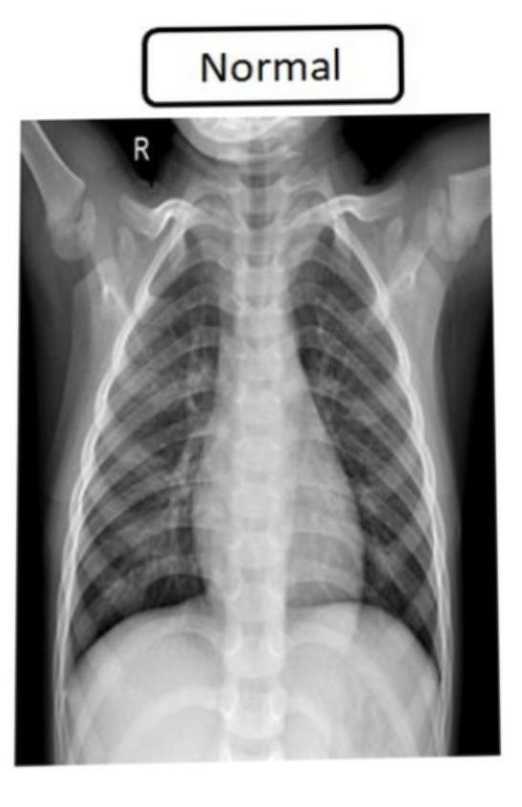
Fig. :Normal chest X-ray
Result

Slide 13
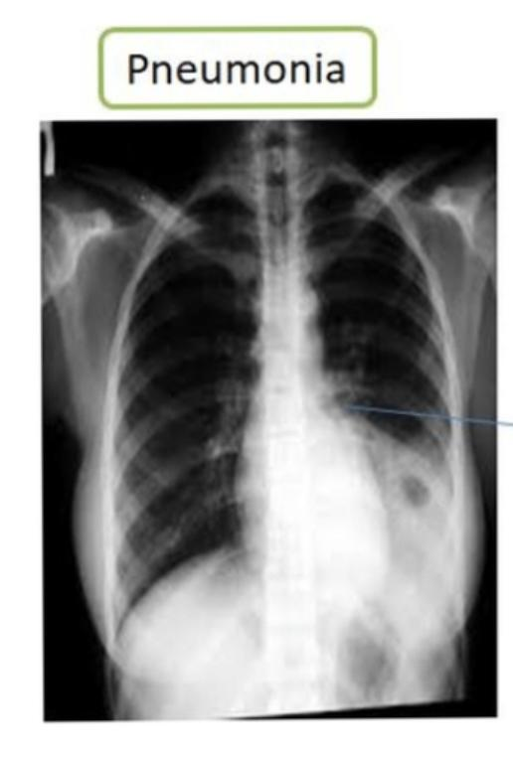
Fig. :Pneumonia chest X-ray

Slide 14
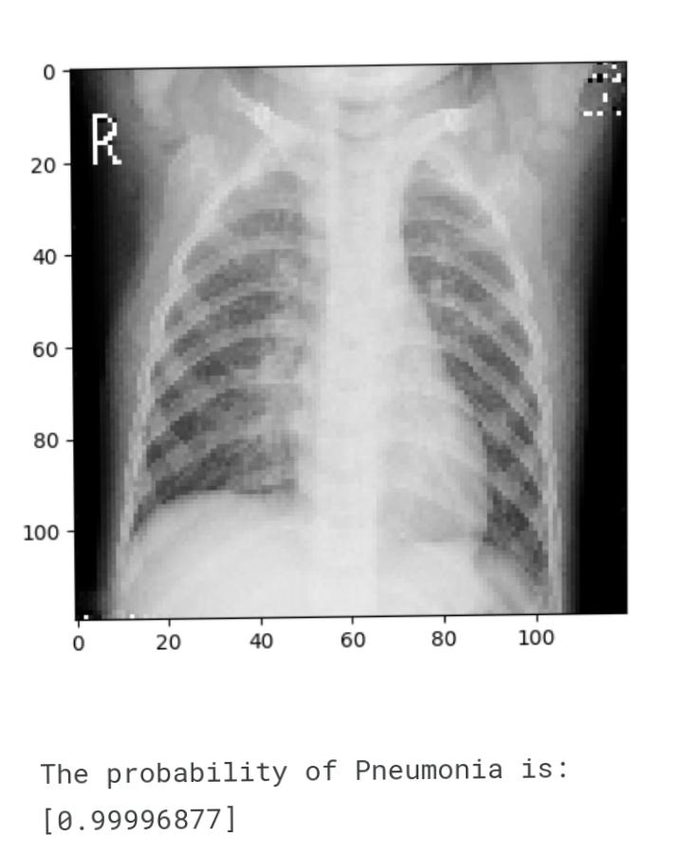
Fig. : Probability of pneumonia

Slide 15
Reference
https://numpy.org/
https://matplotlib.org/
https://pandas.pydata.org/
https://keras.io/
https://www.tensorflow.org/guide/keras
Dataset link:
https://www.kaggle.com/datasets/paultimothymooney/chest-xray-pneumonia/download?datasetVersionNumber=2

Slide 16
Conclusion:
The application of CNN for pneumonia detection has shown promising results in this study. The model demonstrated high accuracy, sensitivity, and specificity in distinguishing between pneumonia-infected and healthy lung images. However, it’s important to acknowledge certain limitations such as dataset size, class imbalance, and potential biases. Future research could focus on addressing these limitations, exploring transfer learning techniques, and incorporating multi-modal data for enhanced diagnosis.

Slide 17
Thank you !..

